Slide 1

Practical Multicolor
Flow Cytometry
Enrico Lugli, PhD
Laboratory of Translational Immunology
Humanitas Flow Cytometry Core
Istituto Clinico Humanitas, Milan, Italy

Slide 2
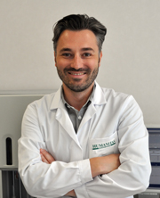
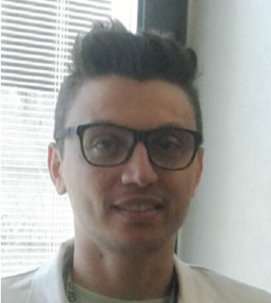
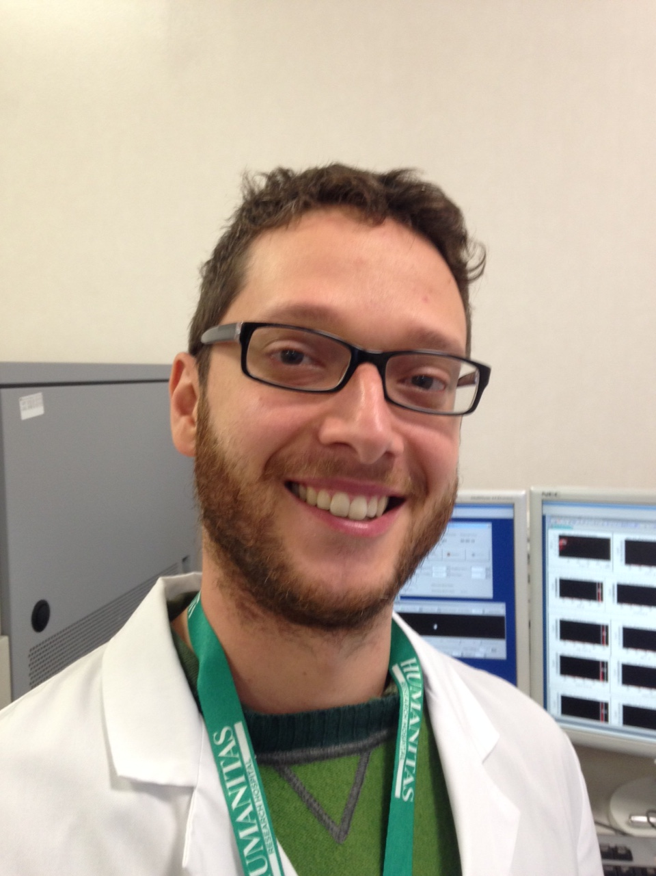
The Humanitas Flow Cytometry Core
Enrico Lugli
Head
Principal Investigator
Achille Anselmo
Technologist, specialist
Federico Colombo
Cell sorting specialist

Slide 3
How to avoid artifacts in flow cytometry
Reagent titration: how to achieve the best separation over background
Multicolor (>1 parameter) compensation
Spreading error in multicolor FACS
Presentation of high quality data for publication

Slide 4
Abs: not just the manufacturer’s instructions
Fresh PBMC stained with 7 two-fold serial dilutions of BV421 anti-CD14 (uL of Ab in 100 uL total volume for 20’ at RT)
Titer:

Slide 5
Abs: not just the manufacturer’s instructions
0.07
0.15
0.3
0.6
1.25
2.5
5
Titer
AIM: Choose the titer at which the best separation between the positive and the negative is achieved without increase in the background.

Slide 6
Abs: not just the manufacturer’s instructions
✓
SNR: Signal-to-noise ratio
MFI: median fluorescence intensity
SNR: MFI (pos) / MFI (neg)
✓
SNR
0.07
0.15
0.3
0.6
1.25
2.5
5
Titer
Titer
AIM: Choose the titer at which the best separation between the positive and the negative is achieved without increase in the background.

Slide 7
Abs: not just the manufacturer’s instructions
Saturating titer: titer at which all receptors are saturated (no increase in positive signal despite the increase of the Ab concentration)
Separating titer: titer at which separation between the positive and the negative is obtained

Slide 8
Titering antibodies: procedure
Start from a given amount of the antibody (generally the concentration suggested by the manufacturer or twice as much) in 100 uL total volume
prepare 8 two-fold serial dilutions, plus unstained
Add cells to each tube (number of cells IS IRRELEVANT – it can be 500K as 10 million)
Incubate at the desired condition (we do 20’ RT)
Transfer 50 uL from one tube to the other
Ab: 40 uL
Buffer: 60 uL
Buffer: 50 uL
Final concentration:
20 uL
10
5
2.5
1.25
0.6
0.3
0.15

Slide 9
Careful with BV dyes

Slide 10
Critical parameters affecting titers
TIME: the longer the incubation the lower the titer needed to reach saturation
TEMPERATURE: some Abs stain better at certain temperatures, e.g. chemokine receptors give a much higher fluorescence when stained at 37°C compared to RT or 4°C
BUFFER: intracellular staining (Fix/Perm buffers) can alter the optimized titer → titrate antibodies with the buffer used in the staining
Cell number DOES NOT affect the Ab titer. The Ab is always in vast excess to the number of molecules, unless cell number changes dramatically.
General rule: the optimized titer can be used to stain up to 10-15 x10⁶ cells in 100 uL total volume

Slide 11
Pro and cons of antibody titration
PRO:
Can save a lot of money (100 tests can become 400)
Better separation, less background
VERY important when performing multicolor analysis (can minimize “spreading” in other channels)
CONS:
None

Slide 12
Optimized voltage settings in FACS experiments

Slide 13
Voltage calibration
Historically, voltage setting has been determined empirically, i.e. voltage is increased (or decreased) to a value capable to show our positive cells
Intuitive when very bright signals are analyzed (e.g., CD8, CD14, GFP)
Not clear when dim antigens are investigated (chemokine receptors, phosphoepitopes)

Slide 14
Voltage calibration
Increased background
Optimized
Voltage
Decreased separation
Optimized voltages to generate the best possible separation over background. Optimized for dim signals
If analyzing bright signals, turn down voltage to bring your cells on scale
Perfetto SP, Nat Protoc, 2012

Slide 15
Fluorescence Compensation

Slide 16
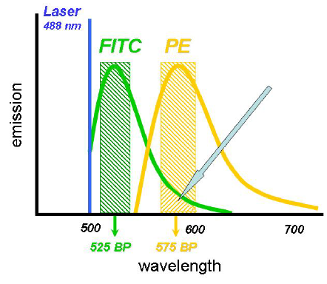
Compensation
Procedure through which the “unwanted” fluorescence from the primary channel (FITC) is removed from the secondary channel (PE)

Slide 17
Compensation: just linear algebra
LINEAR subtraction of the contaminating fluorescence signal from the primary detector
The same value will be subtracted from all the cells in the fluorescence range
Compensation:
1,100:13,000 = x:100
x = 1,100*100/13,000 = 8.46
ca. 1,100
Secondary detector
ca. 13,000
Primary detector

Slide 18
Is this correctly compensated?
Credit: Mario Roederer, VRC, NIH

Slide 19
Aspects to consider
Compensation can be performed manually (at the machine) or automatically (via software)
Manual compensation: tedious, need to check carefully that positive and negative signals have to match
Automated compensation: no errors, if using the right controls
Manual compensation is impractical in a multicolor experiment (roughly 2^{n} pairwise combinations)
Changing compensation in a pairwise combination affects distribution in other channels.

Slide 20
Practical compensation
How do we correctly estimate the “spillover” of a given fluorochrome into other channels?
SINGLE-STAINED CONTROLS

Slide 21
Compbeads for single stained controls
Plastic beads covered with species-specific anti-Fc antibodies (anti-mouse, -rat, -hamster, etc.)
Very bright
PROCEDURE:
Vortex beads
Aliquot 30 uL to each tube (including a negative control)
Add Ab (the same titer used in the staining)
Vortex
Incubate 15’ RT
Wash

Slide 22
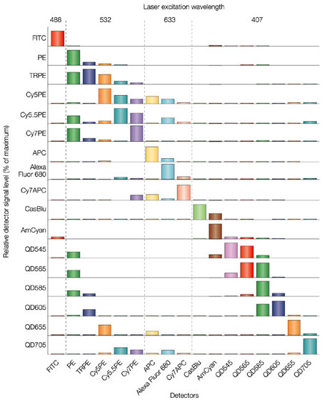
Minimizing compensation
Good 4 color combinations:
FITC – PE-Cy7 – PacBlue – APC
FITC – PE – PacBlue – APC
FITC – PE – PacBlue – APC-Cy7
Success of a panel does not depend on compensation. Panels work fine even when compensation is >100%
Spreading error between channels determines the success of the panel

Slide 23
The 3 golden rules of compensation
Use a single-stained control that is AT LEAST as bright as the test staining
Use the same reagent that is being used in the staining (valid for tandems such as PE-Cy7, APC-Cy7, etc. – for non tandems any reagent is OK)
Have a paired-negative control with the SAME autofluorescence as the positive (cells with cells, beads with beads, etc.)
Everything else is not necessary!

Slide 24
Experiment plan
A 5-color panel is designed to investigate CD3 FITC, CD4 APC, CD8 Cy5PE, CD19 PE and Aqua live/dead (to exclude dead cells)
Tubes:
Unstained comp control
Beads: CD3 FITC
Beads: CD4 APC
Beads: Cd8 Cy5PE
Beads: CD19 PE
Beads: Aqua (positive and negative)
Full stained samples
8-12. FMO controls (up to 5)

Slide 25
Rule #1: at least as bright!
Overcompensation of FITC into Alx594
Comp control is not as bright as the test stain
Alexa 594 CCR7
FITC IFN-γ
Comp control
Test staining: IFNg

Slide 26
How to accomplish Rule #1?
Get a brighter comp (stain with more Ab; use a different Ab, binding beads at higher efficiency, if the Ab is not a tandem)
Decrease Ab titer in staining (not in this case, you will have loss of sensitivity)
Use single-stained cells

Slide 27
Rule #2: different Abs conjugated to the same FL require different compensation
Wrong
Correct
Wrong comp
13.2% subtraction
PE
Correct comp
3.4% subtraction
PE
Negative control
PE-Cy5.5
PE-Cy5.5
Compensation requirements can be different from lot to lot of the same Ab

Slide 28
Changing compensation affects distribution in other channels
FITC (l 525) and PerCP (l 670) are distant enough
Possibly wrong comp between PerCP (l 670) and PE-TxR (l 610)

Slide 29
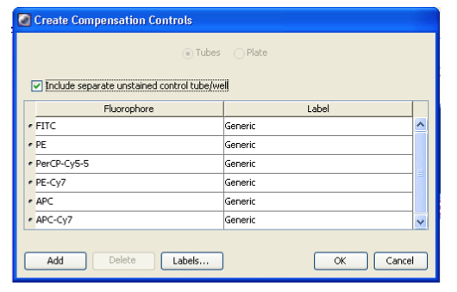
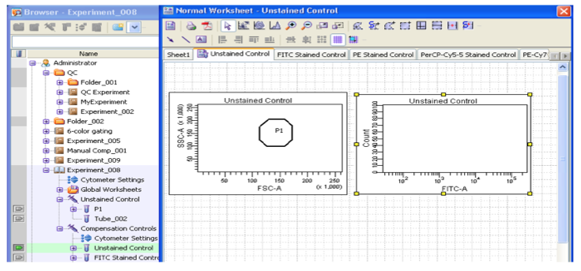
How to compensate in FACSDiva
Choose Experiment → Compensation setup → Create compensation controls
Run single-stained controls, including negative
Select positive and negative signal from each control
For Comp tubes containing both positive and negative, draw an additional gate to select the negative population
Choose Experiment → Compensation Setup → Calculate Compensation.
Enter a compensation setup name, click Link and Save, and click OK.

Slide 30
Spreading error in the muticolor world

Slide 31
Signal spreading
Compensated with transformation
Uncompensated
Compensated
2000
+500
1000
-500
What causes this spread? Photon counting statistics introduces a measurement error
Credit: Mario Roederer, VRC, NIH

Slide 32
“Errors” in compensation
Properly compensated data may not appear rectilinear because of measurement errors (are more prominent in case of limited numbers of photons, Cy7PE or Cy7APC dyes, with low energy)
Measurement errors are directly proportional to the intensity (LOG relationship)
This effect on compensated data is unavoidable, and cannot be corrected with compensation (LINEAR correction)
Compensation does not introduce the error, it only REVEALS it because it brings the distribution to the low end of the log scale

Slide 33
How do we overcome this problem?
Use different gates: cells positive in the primary detector will have a different threshold of positivity compared to negative cells
Alexa 700
APC

Slide 34
How do we overcome this problem?
Use different gates: cells positive in the primary detector will have a different threshold of positivity compared to negative cells
Not a problem if analyzing bright antigens in the secondary detector
100% detected
Alexa 700
APC

Slide 35
How do we overcome this problem?
Use different gates: cells positive in the primary detector will have a different threshold of positivity compared to negative cells
Not a problem if analyzing bright antigens in the secondary detector
Loss of sensitivity if DIM antigen in the secondary detector. Decrease titer of spreading Ab to minimize spreading.
Try a different Ab combination
100%
detected
~50%
detected
Alexa 700
APC

Slide 36
Final considerations for panel development
Ideally not a problem if compensation is very high between fluors (need to be tested in any case)
Voltage amplification determines compensation values but not the final result (we are compensating fluorescence)
No need to set voltages such that the signal in the primary channel is brighter than that in the secondary channel
Spread of signals determines the success of multicolor panels
Compensation: 100%
Compensation: <100%
Secondary detector
Compensation: >100%
Primary detector

Slide 37
Define markers to be used
Dead cell exclusion: Aqua Zombie live/dead discriminator
Lineage: CD3, CD4, CD8, CD45 (optional? → save one channel)
Memory differentiation: CD45RO, CCR7, CD95, CD27, CD57 (minimum set of markers to identify naïve and memory T cell subsets – Lugli, Nat Protoc, 2013)
Defining T cell exhaustion and activation: PD-1 (exhaustion), HLA-DR (activation), Granzyme B and Perforin (cytotoxicity; T cells may still be cytotoxic even though inhibited), T-bet and Eomes (effector functions)
Resident or circulating memory pattern: CD69

Slide 38

Is this panel going to work?

Slide 39

It is difficult to predict, especially the future

Slide 40
Titrate every single reagent
Doesn’t only define correct concentration and if reagents are working, but also gives information to predict spreading error in a given channel → success of the multicolor panel
CD57 BV605
16
17
16
14
Fluorescence
Cy5PE
Concentration
14
12
10
BV605
Roederer, Cytometry, Cytometry. 2001 Nov 1;45(3):194-205; Mahnke, Clin Lab Med. 2007 Sep;27(3):469-85

Slide 41
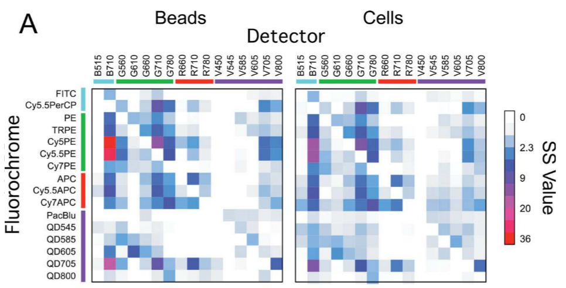
Spillover spreading across all PMTs
Critical combinations
No spread areas
‘Nguyen, Cytometry A, 2013 Mar;83(3):306-15

Slide 42
Choose the best combo
HLA-DR FITC
HLA-DR Cy7APC
Poor separation – Switch to Cy7APC
B cells
Activated T
Resting
Fluorescence
Concentration
Concentration

Slide 43
Panel-specific adjustments
Poor CD95 separation, but always looked fine in regular surface staining
TF buffer is harsh and may alter epitopes
Titration of CD95 with TF buffer
Repeat with adjusted Ab concentration
CCR7 BV711
CCR7 BV711
CD95 Cy5PE
CD95 Cy5PE

Slide 44
Sample-specific adjustments
Blood
Lung tumor
“Optimal” CD8 titer according to titration in blood → too much spread onto other channels due to increased CD8 fluorescence in the tumor
CD8 BV780
Suboptimal CD8 titer to reduce data spread and increase sensitivity in tumor sample
CD4 BV570

Slide 45
Sample-specific adjustments
Lung tissue
Dispensable CD45 staining, CD3 separates very well to identify T cells
Free Cy7APC channel to accommodate HLA-DR and detect activated cells
Aqua Live/dead
CD45 Cy7APC
CD3 BV655

Slide 46
Fluor Antigen Notes
FITC HLA-DR
PerCP5.5 CD45RO
PE IRF4
PE-TxR Eomes
PE-Cy5 CD95
PE-Cy7 T-bet
APC CD45
Alexa700 GrB
Cy7APC CD69
BV421 PD-1
Dump Aqua
BV570 CD4
BV605 CD57
BV650 CD3
BV711 CCR7
BV780 CD8

Slide 47
Fluor Antigen Notes
FITC HLA-DR
PerCP5.5 CD45RO
PE IRF4
PE-TxR Eomes
PE-Cy5 CD95
PE-Cy7 T-bet
APC CD45
Alexa700 GrB
Cy7APC CD69
BV421 PD-1
Dump Aqua
BV570 CD4
BV605 CD57
BV650 CD3
BV711 CCR7
BV780 CD8

Slide 48
Fluor Antigen Notes
FITC HLA-DR Poor, move to Cy7APC
PerCP5.5 CD45RO
PE IRF4
PE-TxR Eomes Not that bright
Sensitive to CD57 spread
PE-Cy5 CD95 TF buffer sensitive
PE-Cy7 T-bet
APC CD45 Dispensable, drop
Alexa700 GrB
Cy7APC CD69 Fine, but move to FITC
BV421 PD-1
Dump Aqua
BV570 CD4
BV605 CD57 Very bright, titer down
BV650 CD3
BV711 CCR7
BV780 CD8 Titer down

Slide 49
Operations
Panel design
Titrate all reagents and predict spreading with titration curves
Test panel
Swap HLA-DR with CD69
Titrate new reagents
Test panel
CD57 still too bright, titer down, test with FMO controls
TF sensitive, re-titer CD95
Test panel on PB and tumor, drop CD45
Replace with Perforin, titrate Ab
EXPERIMENTS!!
1 month to develop 16 color panel, considering backbone
Fluor Antigen Notes
FITC HLA-DR Poor, move to Cy7APC
PerCP5.5 CD45RO
PE IRF4
PE-TxR Eomes Not that bright
Sensitive to CD57 spread
PE-Cy5 CD95 TF buffer sensitive
PE-Cy7 T-bet
APC CD45 Dispensable, drop
Alexa700 GrB
Cy7APC CD69 Fine, but move to FITC
BV421 PD-1
Dump Aqua
BV570 CD4
BV605 CD57 Very bright, titer down
BV650 CD3
BV711 CCR7
BV780 CD8 Titer down

Slide 50
Final panel
CD69
CD45RO
IRF4
Eomes
CD95
T-bet
Perforin
GrB
HLA-DR
PD-1
Aqua
CD4
CD57
CD3
CCR7
CD8
Fluor Antigen Notes
FITC HLA-DR Poor, move to Cy7APC
PerCP5.5 CD45RO
PE IRF4
PE-TxR Eomes Not that bright
Sensitive to CD57 spread
PE-Cy5 CD95 TF buffer sensitive
PE-Cy7 T-bet
APC CD45 Dispensable, drop
Alexa700 GrB
Cy7APC CD69 Fine, but move to FITC
BV421 PD-1
Dump Aqua
BV570 CD4
BV605 CD57 Very bright, titer down
BV650 CD3
BV711 CCR7
BV780 CD8 Titer down

Slide 51
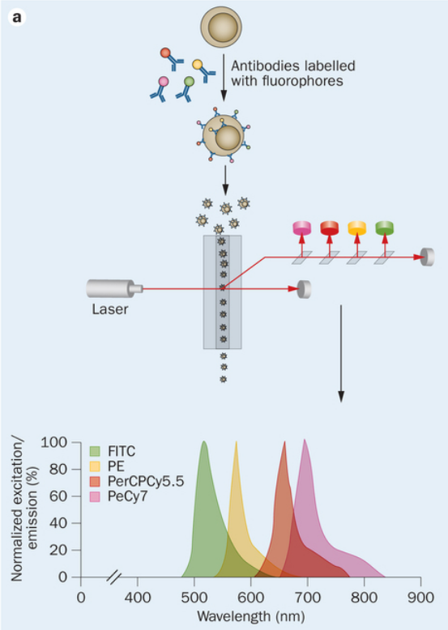
20-parameter FACS
FSC
SSC
BV421
BV510
BV570
BV605
BV650
BV711
BV786
FITC
Cy5.5PerCP
APC
Alexa700
Cy7APC
PE
PE-CF594
Cy5PE
Cy5.5PE
Cy7PE

Slide 52
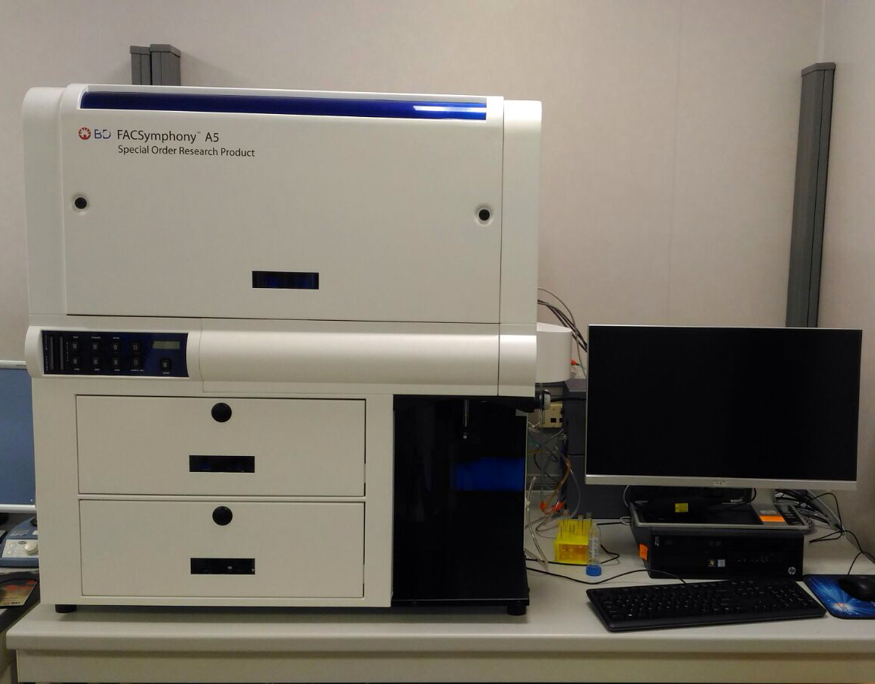
Moving towards 50 parameter FACS
BD Symphony A5
5 lsr: 395 405 488 561 640
BUV395
BUV496
BUV563
BUV615
BUV661
BUV737
BUV805
BB630
BB660
BB700
BB790
BV480
…and new IR and deepUV dyes

Slide 53
A new Age of Enlightenment in FACS
Relative brightness

Slide 54
Flow cytometry data presentation

Slide 55
A call for data integrity in FACS
Science is experiencing an increased number of paper retractions
Frauds: can’t do anything unless giving better supervision
Data quality: gels, statistics, bioinformatics
Flow cytometry is widely used in immunology and hematology
Sample preparation is SIMPLE and for somewhat reasons people think they don’t need training (or need little)

Slide 56
Introducing artifacts in flow cytometry
Instrument setup and calibration (PMT voltage generally dependent on the mood of the operator)
Reagent titration: high background, little separation
COMPENSATION
CONTROLS (define positivity)

Slide 57
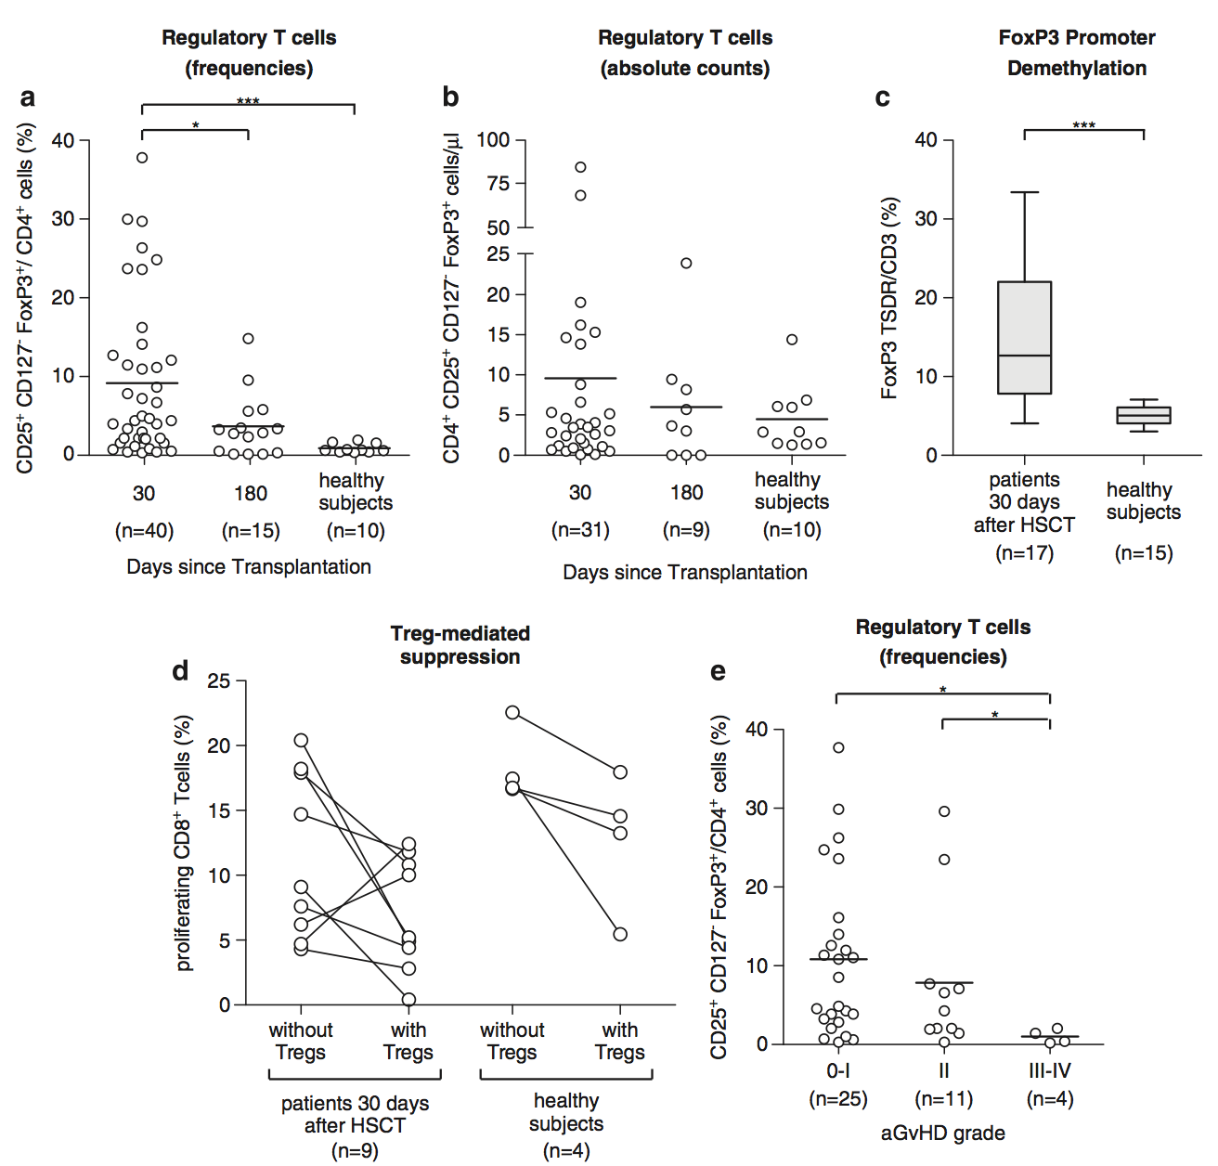
Some papers rely heavily on FACS

Slide 58
Some papers rely heavily on FACS
SHOW ME THE DATA !

Slide 59
Questions arising
Were the data compensated correctly?
And the gating? Same gates used for all patients/controls?
Were antibodies titrated?
How many cells were acquired? Treg cells are ~5% of CD4⁺, transplanted people are lymphopenic. Methods can report 1,000,000 cells were acquired – but what if the frequency of total CD3⁺ is 1%?
Cannot tell if raw data are not provided

Slide 60
Outline
Data display methods
Dot vs. density plot vs. contour
Gating strategy
Type of gating

Slide 61
Avoid histograms (or be careful)
Histograms are very intuitive but display only one parameter (we now live in a multicolor world)
88.1
Under
compensated
CD4
77.8
Correctly
compensated
CCR7
CCR7

Slide 62
Dot vs. density plot vs. contour
Multiple ways to display data – use depends on applications
Color
Contour
CCR7
Density
Dot
CD45RA

Slide 63
Saturated areas by events
Number of events
50,000
150,000
300,000
300,000
CCR7
CD45RA

Slide 64
Dots are useful with low numbers
PBMCs were stimulated with pool of peptides to induce cytokine production (identification of ag-specific T cells)
Determine the memory phenotype of cytokine producing cells
Unstimulated
Peptide stimulated
IFN-g
IL-2

Slide 65
Dots are useful with low numbers
High resolution
(can’t see anything)
Low resolution
(better, but gates?)
CCR7
No idea of number of events
CD45RA

Slide 66
Dots are useful with low numbers
Total CD8+
Ag-specific
Dots overlaid on density plot
Contrasting colors
Total CD8+ cells allow to see population distribution

Slide 67
Complex experiments: gating strategy
Why is this important? Tells you whether:
the authors have experience with FACS
gates were performed correctly (polygon vs. quadrants as a consequence of spreading)
Dead cells were excluded in the right way
There is contamination from unwanted populations
Cells were chosen correctly on the basis of FSC and SSC

Slide 68
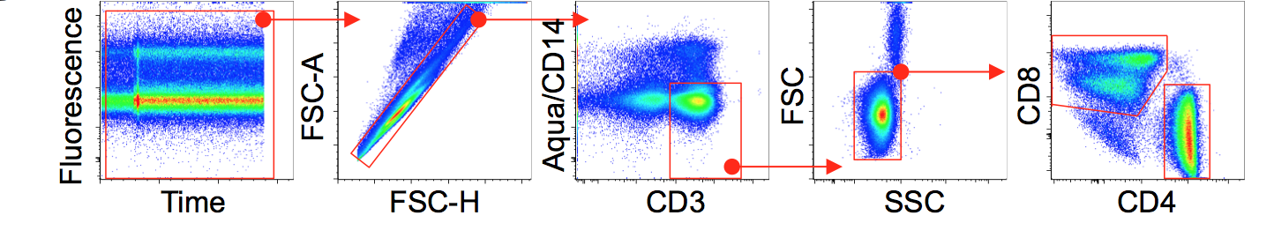
Memory T cells: full gating strategy
Is fluorescence stable over time?
Spreading of CD8 into CD4: optimal gate?
Dead cells excluded correctly? Contaminating populations such as Monos?
Doublets excluded?
Only small lymphocytes or also large lymphocytes included?

Slide 69
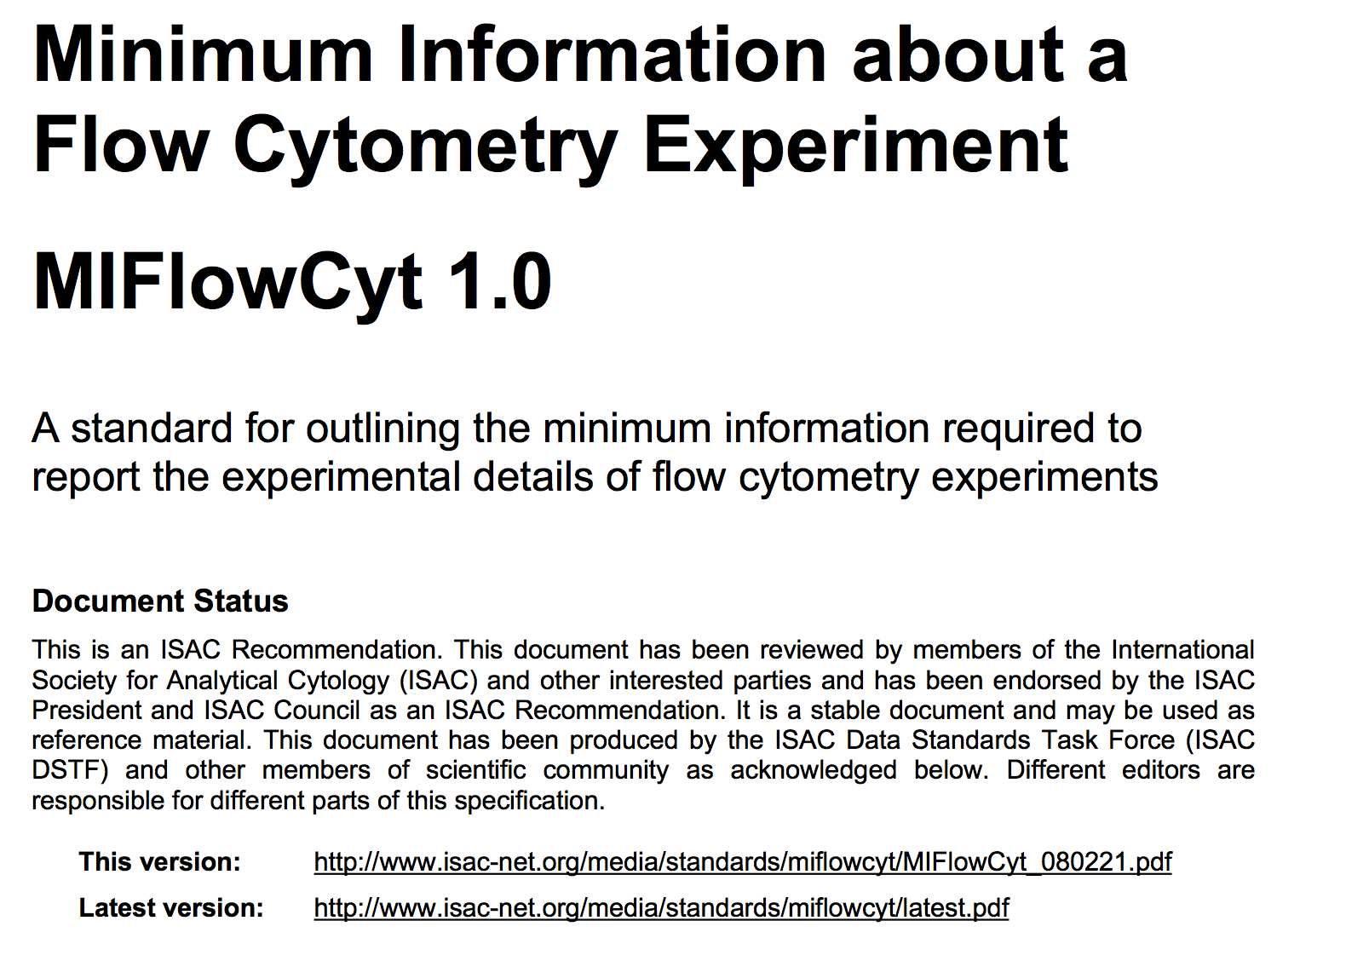
MIFlowCyt – ISAC standards for data display

Slide 70
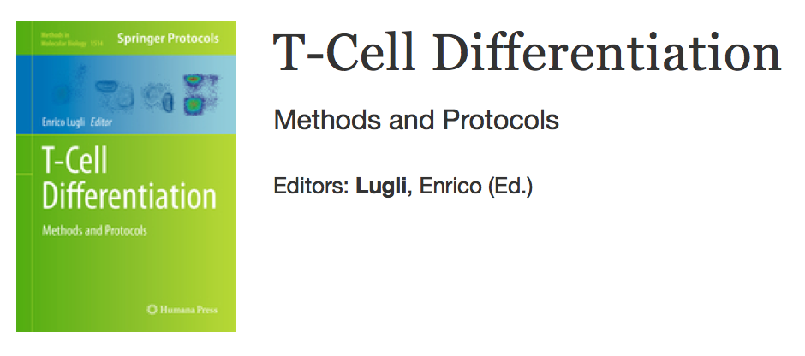
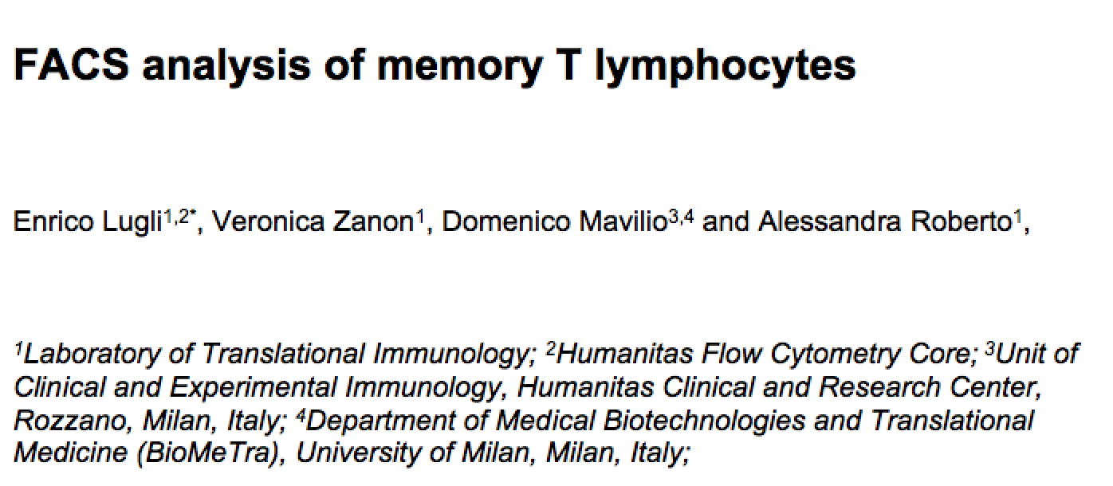

Slide 71
enrico.lugli@humanitasresearch.it

